Slide 1
Introduction
Approximation (“granulation”): A color can be described precisely using RGB values, or it can be approximately described as “red”, “blue”, etc.
Degree (“graduation”): Two different colors may both be described as “red”, but one is considered to be more red than the other
Fuzzy logic attempts to reflect the human way of thinking
Fuzzy logic is a generalization of standard logic, in which a concept can possess a degree of truth anywhere between 0.0 and 1.0.
Standard logic applies only to concepts that are completely true or completely false.
We can have fuzzy propositional logic and fuzzy predicate logic.

Slide 2
Terminology (Contd.)
Fuzzy set: A set X in which each element y has a grade of membership µX(y) in the range 0 to 1, i.e. set membership may be partial is called fuzzy set. e.g. if cold is a fuzzy set, exact temperature values might be mapped to the fuzzy set as follows:
15 degrees → 0.2 (slightly cold)
10 degrees → 0.5 (quite cold)
0 degrees → 1 (totally cold)
Crisp set: In crisp set, elements are either the member of a set or not, partial membership is not allowed.
Fuzzy variable: Variable with (labels of) fuzzy sets as its values.
Linguistic variable: Fuzzy variable with values that are words or sentences in a language. e.g. variable color with values red, blue, yellow, green…
Linguistic hedge: Term used as a modifier for basic terms in linguistic values e.g. words such as very, a bit, rather, somewhat, etc.
Fuzzy Membership Function: Fuzzy Membership Function transforms the input data to a 0 to 1 scale based on the possibility of being a member of a specified set.

Slide 3
Simple Fuzzy Operators
As described by Zadeh (1973)…
NOT X = 1 - µX(y)
e.g. 0.8 cold → (1 – 0.8) = 0.2 NOT cold
X OR Y (union) = max(µX(y), µY(y))
e.g. 0.8 cold, 0.5 rainy → 0.8 (cold OR rainy)
X AND Y (intersection) = min(µX(y), µY(y))
e.g. 0.9 hot, 0.7 humid → 0.7 (hot AND humid)

Slide 4
Alternative Interpretations of AND and OR
Zadeh’s definition of AND used the Gödel t-norm, but other definitions are possible using different t-norms
Common examples:
Product t-norm: µX (y) * µY (y)
e.g. 0.9 hot, 0.7 humid → 0.63 hot AND humid
Lukasiewicz t-norm: max(µX (y) + µY (y) - 1, 0)
e.g. 0.9 hot, 0.7 humid → 0.6 hot AND humid
Similar possibilities for OR using corresponding t-conorms:
Product t-conorm: µX (y) + µY (y) - µX (y) * µY (y)
e.g. 0.8 cold, 0.5 rainy → 0.9 cold OR rainy
Lukasiewicz t-conorm: min(µX (y) + µY (y), 1)
e.g. 0.8 cold, 0.5 rainy → 1 cold OR rainy
0.9x0.7=0.63
0.9+0.7=1.6-1=0.6 max(0.6,0)=0.6

Slide 5
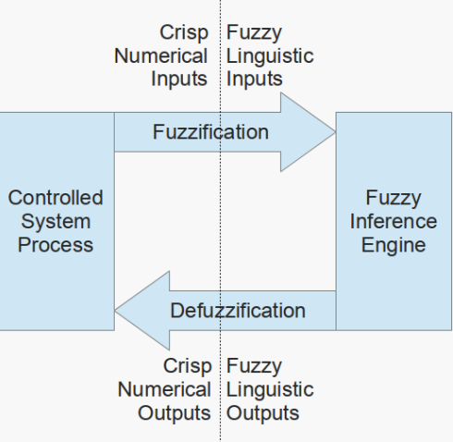
Fuzzy System Overview
Fuzzification:
The process of converting crisp numerical input values into fuzzy linguistic values by mapping them to appropriate membership functions. The result is a degree of membership (between 0 and 1) in corresponding fuzzy sets.
Defuzzification:
The process of converting fuzzy output values (represented by fuzzy sets and their degrees of membership) back into a single crisp numerical value for decision-making or control purposes.

Slide 6
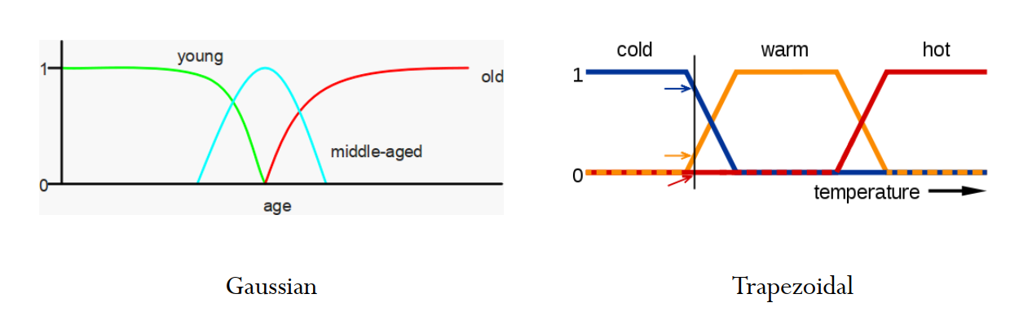
Fuzzification methods:
singleton fuzzifier
Gaussian fuzzifier, and
trapezoidal or triangular fuzzifier

Slide 7
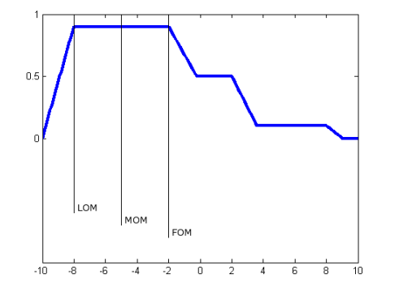
Defuzzification methods:
First of maximum
Middle of maximum
Last of maximum
Mean of maxima
Random choice of maximum
The first of maximum, middle of maximum, and last of maximum would be -2, -5, and -8 respectively as seen in the diagram.

Slide 8
Examples

Slide 9
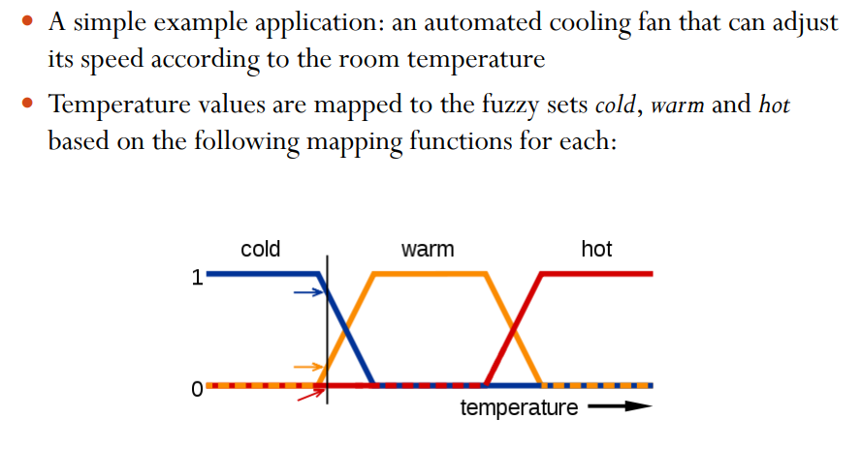
Fuzzy Control Systems

Slide 10
Fuzzy Logic in Washing Machine
1. Inputs (sensed values)
The machine uses sensors to collect data such as:
Load weight (how many clothes)
Fabric type (cotton, synthetic, wool, etc.)
Dirt level (how dirty the clothes are)
Water temperature
Detergent amount
These inputs are often uncertain or imprecise, making them perfect for fuzzy logic.
2. Fuzzification
The crisp sensor values are converted into linguistic variables:
Load → Small, Medium, Large
Dirt level → Light, Medium, Heavy
Fabric → Delicate, Normal, Sturdy

Slide 11
Fuzzy Logic in Washing Machine
3. Fuzzy Rule Base (IF–THEN rules)
The washing machine applies rules like:
IF load is Large AND dirt is Heavy → THEN wash time is Long
IF fabric is Delicate → THEN spin speed is Low
IF dirt is Light AND load is Small → THEN water usage is Low
4. Inference Engine
The fuzzy controller evaluates all rules and determines suitable washing parameters.
5. Defuzzification
The fuzzy results are converted back to crisp control actions such as:
Exact wash time (e.g., 42 minutes)
Water level (e.g., 35 liters)
Spin speed (e.g., 600 RPM)
Detergent amount

Slide 12
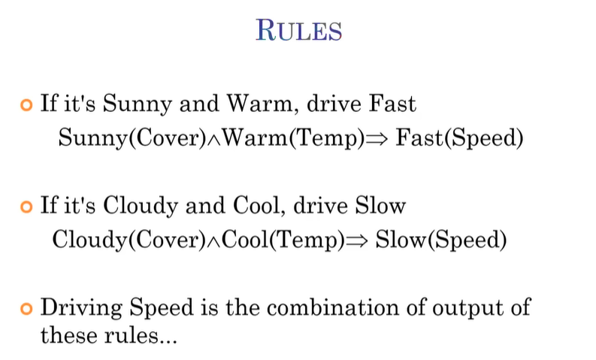
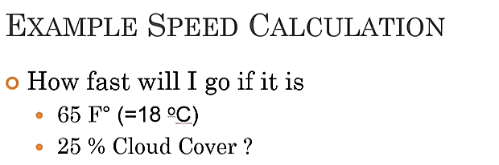

Vehicle Speed (Example)

Slide 13
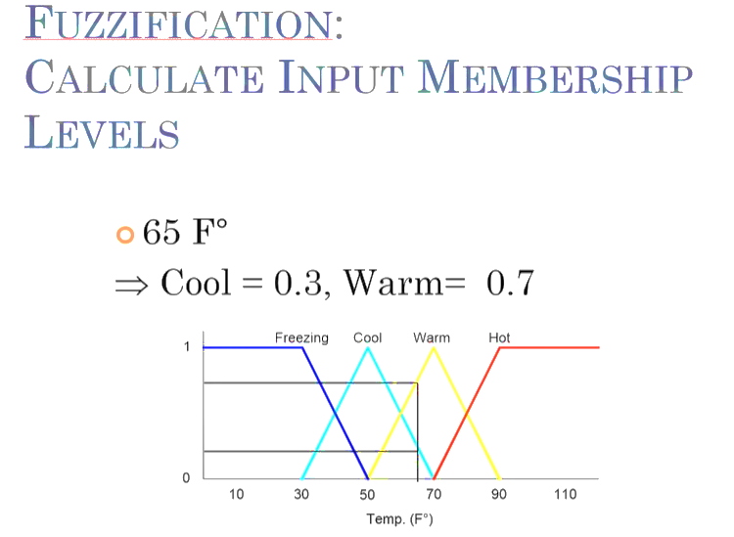

Slide 14
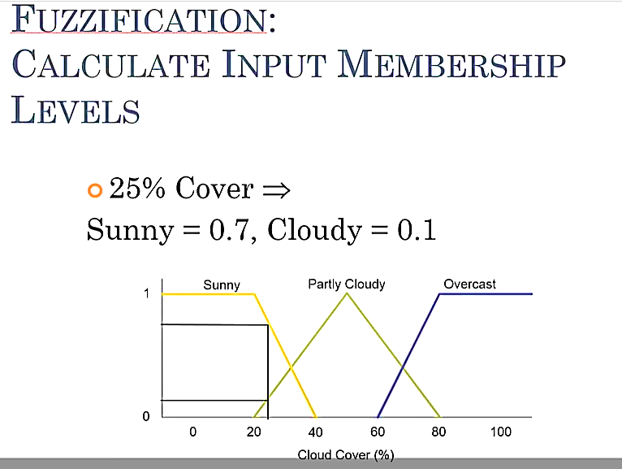

Slide 15
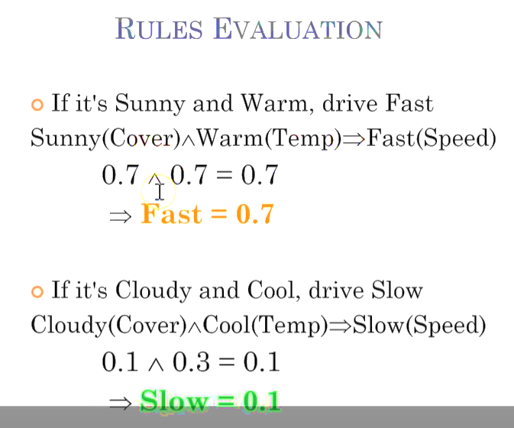

Slide 16
